Slide 1

“AI-Based Interview Facilitator App V2”
IBRAHIM KHAN CIIT/FA21-BSE-096/ATD
DAUD RAZZAQ CIIT/FA21-BSE-112/ATD
UM-E-AIMEN CIIT/FA21-BSE-038/ATD
Supervisor
BUSHRA MUSHTAQ
Department of Computer Science
COMSATS University Islamabad, Abbottabad Campus

Slide 2
Agenda of the Presentation
Introduction
Scope
Functional Requirements
Non-Functional Requirements
User Goals
Use Cases
Use Case Diagram
System Sequence Diagram
Activity Diagram
Deployment Diagram
Gannt Chart
First iteration 30%
Second iteration 60%
Final Thought

Slide 3
Brief Introduction
The AI-Based Interview Facilitator will improve traditional interviews by generating related pool of questions , based on extracted information from candidates' CVs and targeted job type.
The pool of questions will include candidate’s education, experience, skills, and interests.
The app will also support remote interviews, providing real-time monitoring of facial expressions, eye contact, and signs of distraction.

Slide 4
Scope
Our app will:
Use machine learning model to generate questions based on the candidate’s CV and targeted job type.
Support both in-person and remote interviews.
Provide real-time monitoring of verbal and non-verbal cues in case of remote interviews.
Real time report generation and dispatching to relevant authorities.
In live interviews will support only one speaker(interviewer/candidate) at a time
Will only support English language.

Slide 5
Functional Requirements
Login/Registration
CV Submission
Question Pool Generation
Conduct Interview(Live/Online)
Dynamic Follow-up Question Generation
Real-Time Transcription
Non-Verbal Analysis
Report Generation

Slide 6
Non-Functional Requirements
Usability
Performance
Reliability
Security
Scalability
Maintainability
Availability

Slide 7
User Goals
Automatically generate role-specific questions from candidate CVs.
Categorize questions by difficulty for a balanced assessment.
Facilitate smooth remote interviews with real-time monitoring.
Use facial expression and behavior analysis to identify signs of distractions or cheating.
Allow interviewers to choose between interview type.
Provide data-driven insights to improve decision-making and efficiency in recruitment.

Slide 8
Use Cases
Login/Registration
Manage Both Interviewers and Candidates
Submit CV
CV Data Analysis
Question Pool Generation
Follow-up Questions Generation
Conduct Interview
Ask Questions
Answer Questions
Real-time Transcription
Non-Verbal Analysis
Report Generation
Review Report
Share Report

Slide 9
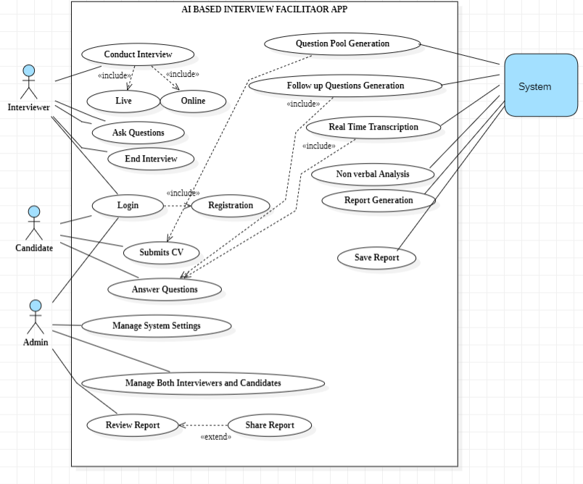
Use Case Diagram

Slide 10
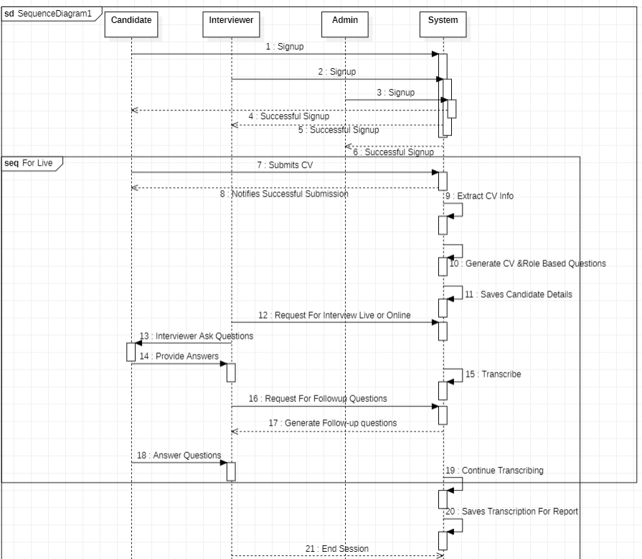
System Sequence Diagram

Slide 11
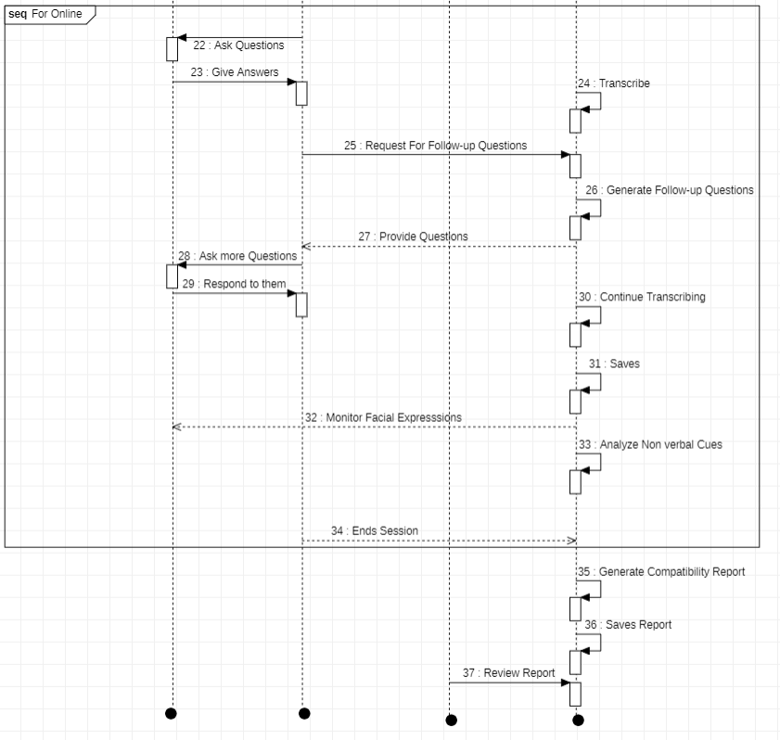
System Sequence Diagram cont..

Slide 12
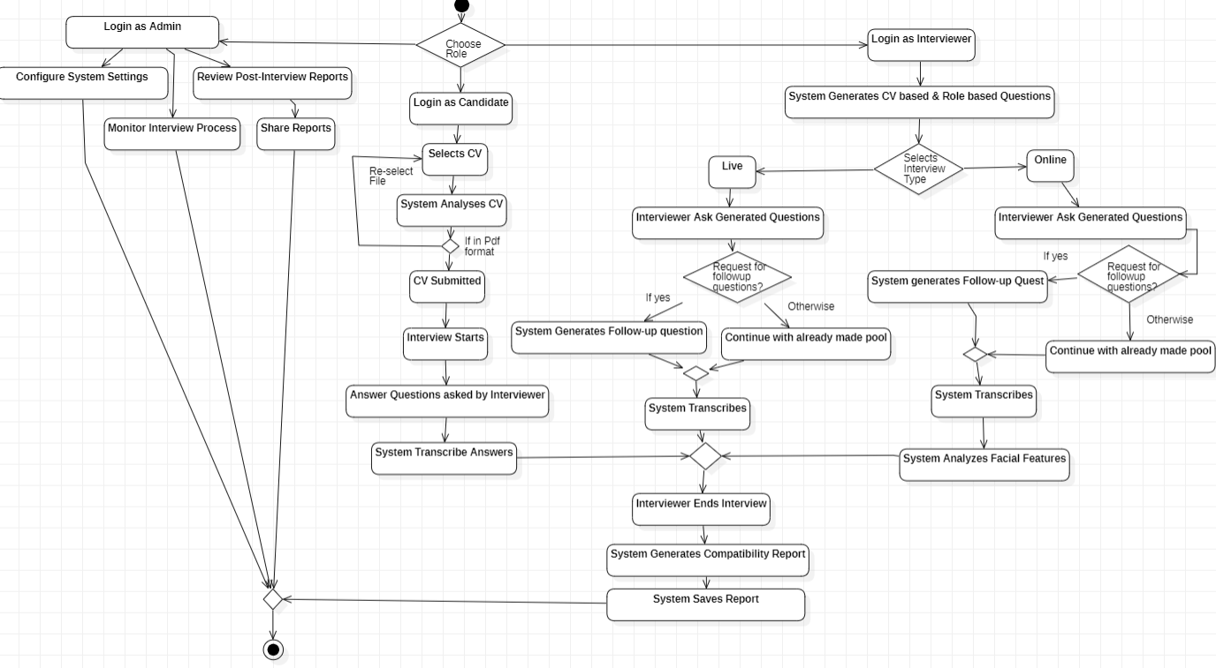
Activity/State Machine Diagram

Slide 13
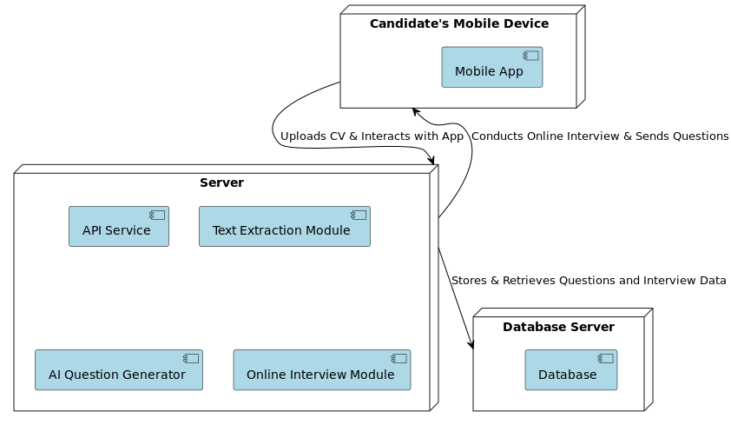
Deployment Diagram

Slide 14
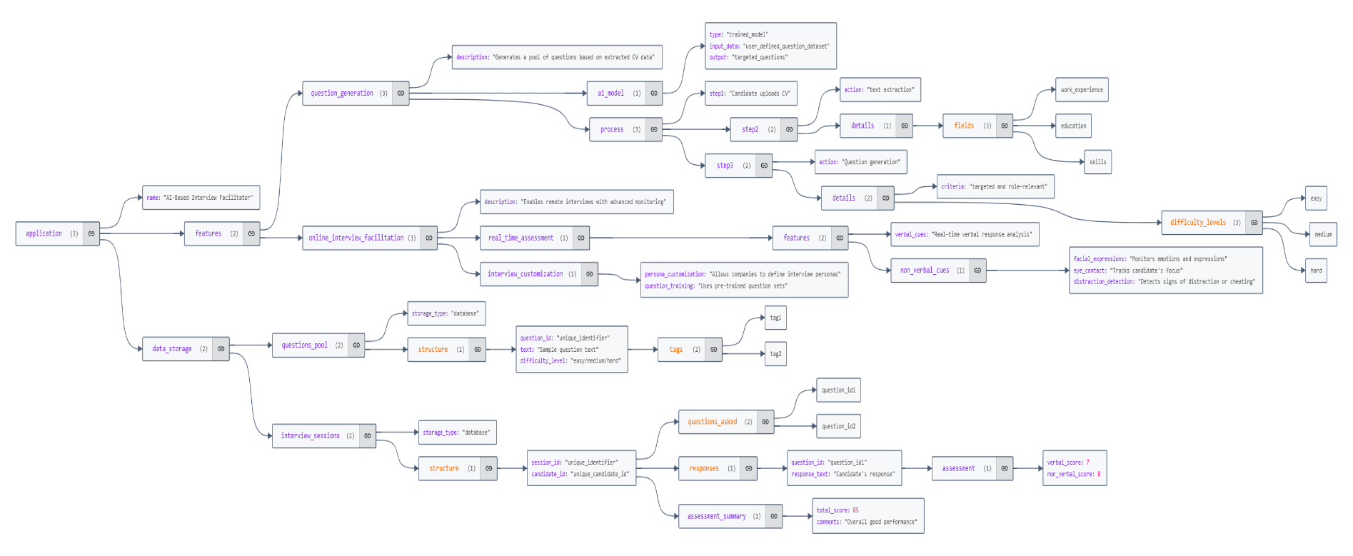
Json Tree

Slide 15
Pseudocode
Algorithm & Implementation we'll provide pseudocode for the key algorithms in the AI Interview Facilitator project. These algorithms represent the core functionalities of the main components in our system.
Function: registerUser(userData)Description: Handles user registration
Algorithm:
1. VALIDATE userData (check for valid email format, password strength, etc.).
2. IF userData is valid THEN
a. CREATE new user in the database.
b. RETURN success message and user ID.
3. ELSE.
RETURN error message.

Slide 16
Pseudocode Cont…
2. Function: loginUser(credentials)Description: Authenticates user credentials for login.
Algorithm:
1. VALIDATE credentials (check if the email format and password length are correct).
2. QUERY the database for the user's email.
3. IF email exists AND password matches THEN
a. CREATE a session token.
b. RETURN success message and session token.

Slide 17
Pseudocode Cont…
4. ELSE
a. RETURN error message ("Invalid email or password").
resumeFile ← null
loading ← false
fileUri ← null
uploadedLink ← null
extractedData ← null

Slide 18
Pseudocode Cont…
Function CALL DocumentPicker to select a PDF fileIF file is selected THEN
SET fileUri ← file's URI
SHOW alert "File Selected“
ELSE
SHOW alert "No File Selected“
ENDIF
error occurs THEN
LOG error
SHOW alert "Error selecting file
"ENDIF

Slide 19
Pseudocode Cont…
IF fileUri is null THEN
SHOW alert "Please select a file"
RETURN
ENDIF
SET loading ← true
TRY
CALL uploadPDFToFirebase(fileUri) → downloadURL
SET uploadedLink ← downloadURL
WAIT 2 seconds (simulating processing delay)

Slide 20
Pseudocode Cont…
SEND POST request to BACKEND_ONE_URI with { pdf_url: downloadURL }
IF response is successful THEN
SET extractedData ← response.extracted_data
SHOW alert "File processed successfully“
ELSE
LOG backend error
SHOW alert "Error processing file on backend“
ENDIF

Slide 21
Pseudocode Cont…
CATCH error
LOG error
SHOW alert "Upload failed"FINALLY
SET loading ← false

Slide 22
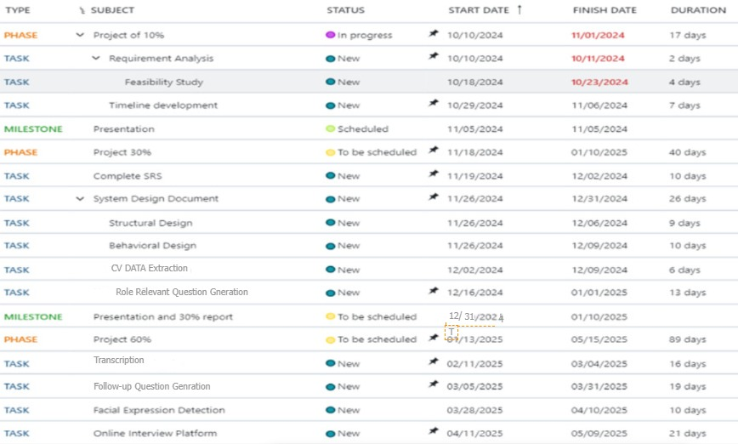
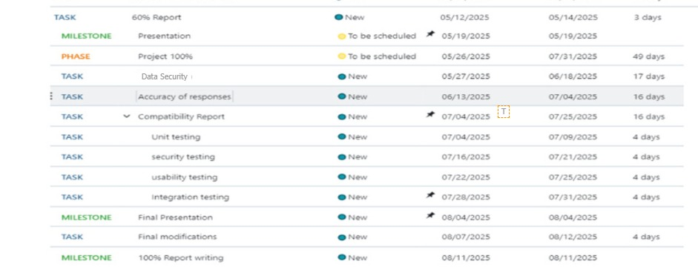
Schedule

Slide 23
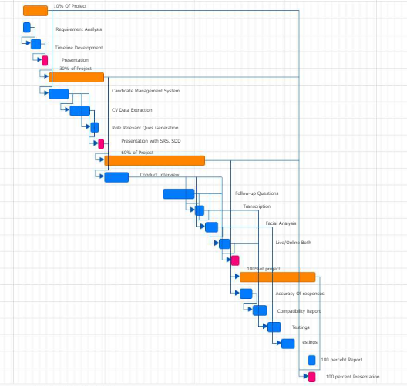
Gantt Chart

Slide 24
Details of 1st Iteration (30%)
Successfully implemented an AI model to extract key information (work experience, education, skills) from candidates' uploaded CVs.
Developed an AI model to generate role-specific questions based on the extracted CV data.
Implemented a candidate management system to track and organize candidate information.

Slide 25
Details of 2nd Iteration (60%)
We’ll try covering remaining major modules of the application.
Conduct Interview(Live/Online)
Dynamic Follow-up Question Generation
Real-Time Transcription
Non-Verbal Analysis

Slide 26
Final Thought
In summary, our application is designed to make interviews smoother and more effective. It will create personalized questions, analyze candidates' responses and expressions in real time, and generate insightful reports.
This system provides a fair way to evaluate skills, track engagement, and give quick feedback, helping recruiters make unbiased and efficient hiring decisions.

